Slide 1




SPA with AngularJS
Super Heroic JavaScript MVC Framework
SoftUni Team
Technical Trainers
Software University
http://softuni.bg

Slide 2

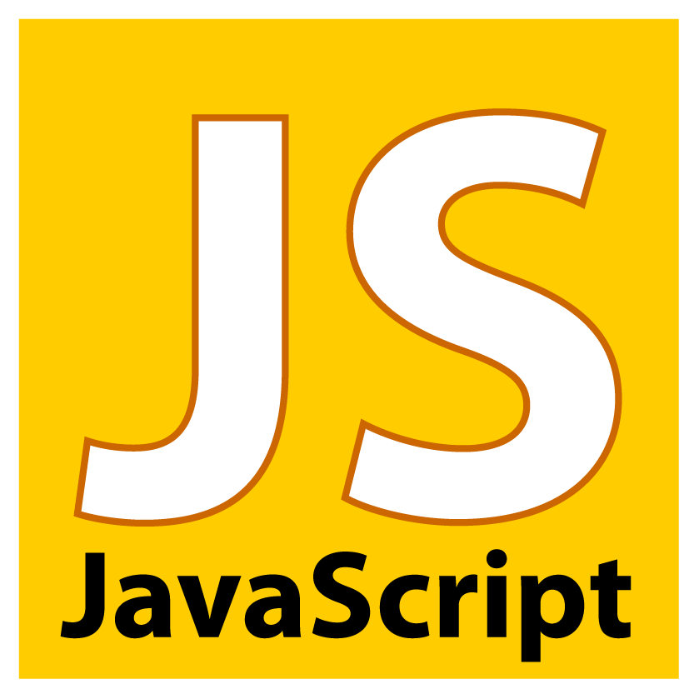
Table of Contents
Course Objectives
Course Program
Trainers Team
Examination
Learning Resources

Slide 3


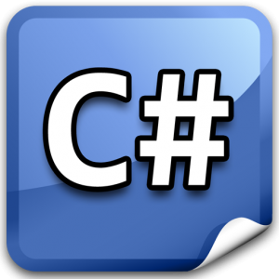
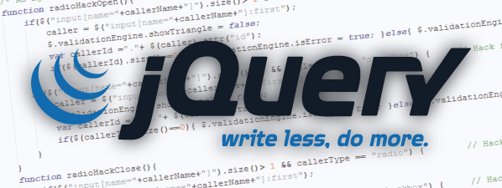

Level #2 at the Software University
Object-Oriented Programming
11 times + TW + exam
6 weeks * 2 times
JavaScript OOP
5 times + exam
3 weeks * 2 times
JavaScript Applications
6 times + TW + exam
4 weeks * 2 times
AngularJS
4 times + project
3 weeks * 2 times
High-Quality Code
16 times + team work project (TW) + Exam
16 weeks * 1 times

Slide 4

SPA with AngularJS
Course Objectives & Program

Slide 5


SPA with AngularJS – Course Program
Course Introduction – course program, exams, trainers, evaluation, resources
Introduction to AngularJS – overview, resources, simple application, modules
Controllers and Markup – controllers, $scope object, markup, binding, filters, validation
Services – custom and built-in-services
Routing – using routes, templates, partial views
Directives – creating directives, attribute specifics, jQuery as directive
Practical Project with AngularJS – Building SPA with AngularJS (live demo)
Practical Project Defense – Practical project at home and live defense

Slide 6

Warning: Not for Absolute Beginners
The "SPA with AngularJS" course is NOT for absolute beginners
Take the "JavaScript Applications" course at SoftUni first: https://softuni.bg/courses/javascript-applications
The course is OK for beginners, but requires previous coding skills
Requirements
JS coding skills – entry level
Computer English – entry level
Logical thinking
coding skills
required!

Slide 7

The Trainers Team

Slide 8

Trainers Team
Ivan Kashukeev
Front-end Developer
Studied at the Telerik Academy
Website / blog developer
Manager of own IT company

Slide 9
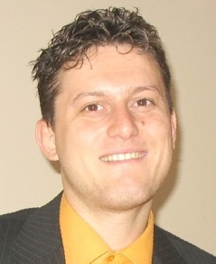
Trainers Team
Svetlin Nakov, PhD
Training & Inspiration Manager @ Software University
20+ years software development experience
10+ years experience as trainer
Author of 7 programming books
Speaker at hundreds of events
Web site & blog: www.nakov.com

Slide 10
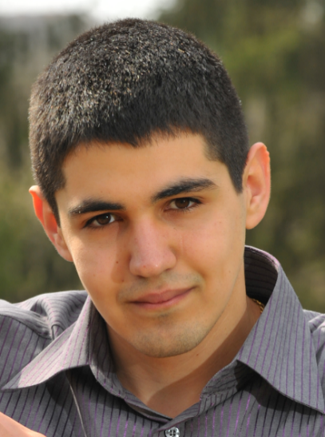

Trainers Team (2)
Vladimir Georgiev
Software engineer and Trainer @ Software University
Top performing graduate from the Software Academy (2013)
Volunteer Trainers / Assistants
Top students from SoftUni
Will teach workshops / advanced topics / labs

Slide 11

SPA with AngularJS: More Details
Duration, Languages, Technologies

Slide 12


Training Duration – SPA with AngularJS
Lectures: ~ 12 hours (onsite + YouTube videos)
Practical exercises (in class): ~ 12 hours
Homework: ~ 30-40 hours
Team project: ~ 10-20 hours
Practical project preparation: 4 hours
Practical project: ~ 30-40 hours
Schedule: Dec 2014-Jav 2015
Practical Project Defense: ~ 5-7 January 2015

Slide 13



Why English?
Why the slides are in English?
English is the native language of the software engineers
Specific terminology should be in English
Translations are inaccurate and funny
Just learn English!
No excuses

Slide 14
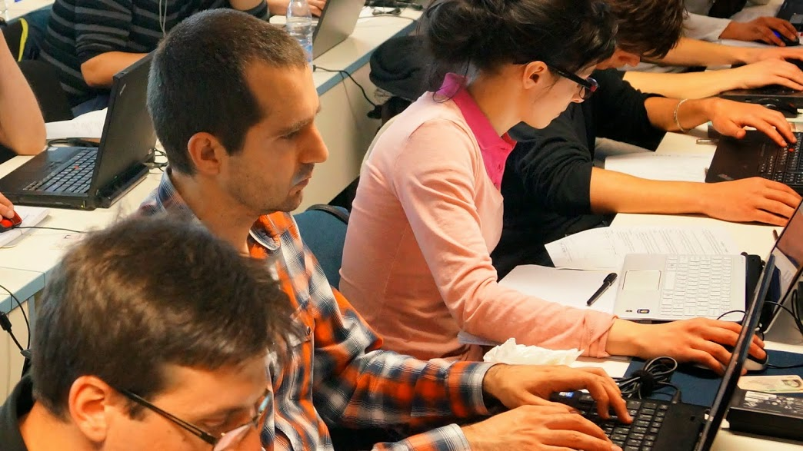


SPA with AngularJS
Evaluation Criteria

Slide 15

Scoring System for the "SPA with AngularJS"
Practical Project – 90%
Homework + evaluation – 5% + 5%
Presence in class: 5% (onsite students only)
Bonuses: up to 10%

Slide 16

SPA with AngularJS - Practical Project
1 practical home project
You are given REST services
Consume given REST services and visualize data
Your project should be written in AngularJS
Your project should correctly follow principles of high-quality-code
Practical home project
The total practical project score comes from live defense by the SoftUni team

Slide 17

Homework Assignments
Doing your homework is very important!
Programming can only be learned through a lot of practice!
You should write code every day!
Each lecture is followed by a few exercises
Try to solve them in class
The rest are your homework
Homework assignments are due in 1-2 weeks after each lecture
Submission will be accepted through our web site: softuni.bg

Slide 18

Homework Peer Reviews
Give feedback to a few random homework submissions
Students submit homework anonymously
Please exclude your name from the submissions!
For each homework submitted
Students evaluate 3 random homeworks
From the same topic, after the deadline
Give written feedback, at least 200 characters
Low-quality feedback → report for punishment
Everyone will get feedback for their homework

Slide 19





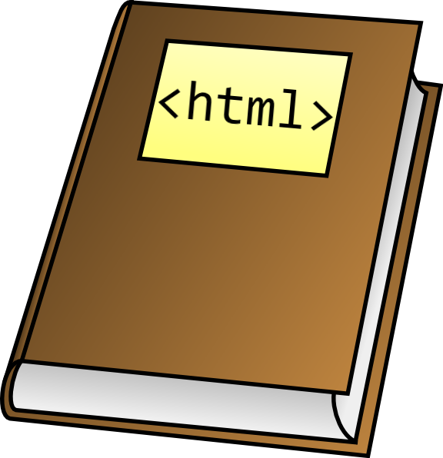



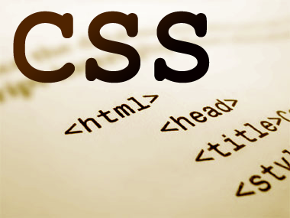
Resources
What We Need Additionally?

Slide 20

Course Web Site & Forums
The JavaScript Applications official web site:
Register for the "Software University Forum":
Discuss the course exercises with your colleagues
Find solutions for all course exercises
Share source code / discuss ideas / help each other
https://softuni.bg/trainings/coursesinstances/details/1075
https://softuni.bg/forum

Slide 21



SPA with AngularJS Slides and Videos
All lecture slides, videos, homework assignments, projects and other resources are open content, available for free
Visit the course web site to access the course resources

Slide 22

SPA with AngularJS Resources
http://angularjs.org/
http://docs.angularjs.org/api
https://github.com/jmcunningham/AngularJS-Learning
https://www.youtube.com/watch?v=i9MHigUZKEM
http://fastandfluid.com/publicdownloads/AngularJSIn60MinutesIsh_DanWahlin_May2013.pdf

Slide 23
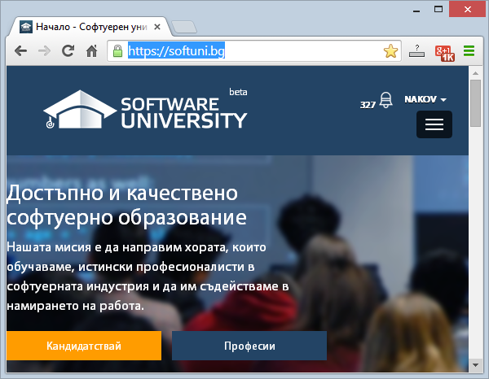
Software University Learning System (SULS)
Software University Learning System (SULS)
www.softuni.bg
Important resource for students
Homework submissions
Homework check-up
Exams and results
Reports about your progress
…

Slide 24


Recommended Software
Microsoft Visual Studio 2013 + Node.js Tools
Sublime Text
WebStorm

Slide 25


Summary
The "SPA with AngularJS" course teaches
How to build SPA applications with AngularJS
Training program
Introduction, controllers, markup, services, routing, directives, live demo
Practical exam
Code review
Learning resources
Lectures, videos, software, books, forum
JS Apps

Slide 26







SPA with AngularJS
https://softuni.bg/courses/spa-applications-angularjs

Slide 27
License
This course (slides, examples, demos, videos, homework, etc.) is licensed under the "Creative Commons Attribution-NonCommercial-ShareAlike 4.0 International" license
Attribution: this work may contain portions from
"SPA with AngularJS" course by Telerik Academy under CC-BY-NC-SA license

Slide 28




Free Trainings @ Software University
Software University Foundation – softuni.org
Software University – High-Quality Education, Profession and Job for Software Developers
softuni.bg
Software University @ Facebook
facebook.com/SoftwareUniversity
Software University @ YouTube
youtube.com/SoftwareUniversity
Software University Forums – forum.softuni.bg

